Slide 1
Employee Data Analysis using Excel
STUDENT NAME: R.priyadharshini
REGISTER NO:312211738 (NM ID: 5AF5B0CF884C71694064EAF80B3FA156)
DEPARTMENT: Department Of Commerce General
COLLEGE: Thiruthangal Nadar college

Slide 2
PROJECT TITLE
Salary And Compensation Analysis
Through Excel Data Modeling

Slide 3


AGENDA
Problem Statement
Project Overview
End Users
Our Solution and Proposition
Dataset Description
Modelling Approach
Results and Discussion
Conclusion
3/21/2024 Annual Review

Slide 4

PROBLEM STATEMENT
Analyze current salary and compensation data to
Identify areas for improvement.
2. Develop a data-driven approach to optimize
Optimize compensation packages
3. Ensure equity , competitiveness , and alignment
With industry standards

Slide 5

PROJECT OVERVIEW
In today’s competitive job market , understanding and
Optimizing salary and compensation structures is crucial
for businesses to attract and retain top talent .This
Project aims to develop a comprehensive excel data
Model to analyse and visualize salary and compensation
Data , enabling organization organization to make
Informed decisions about their compensation
Strategies.
.

Slide 6


WHO ARE THE END USERS?
Manager
Administrations
Hierarchy

Slide 7

OUR SOLUTION AND ITS VALUE PROPOSITION
Filtering - Remove missing values
Conditional formatting – Blanks
Pivot table - summary of credit rating
Formulas - IFS
Graphs - Final report

Slide 8
Dataset Description
Employee ID: Unique identifier for each employee in the organization.
First Name: The first name of the employee.
Last Name: The last of the employee.
Current employee rating: The current rating or evaluation of the employee‘s overall performance.
Gender: A code representing the gender of a employee .
Job function: A brief description of the employee‘s performance level.
Start date: The employee joined date.
Exit date: The employee leaves an organization date.
Employee type: The different type of employees that an organization may contract, full time and part time.
Employee status: The legal relationship between and employee and their employer.

Slide 9

THE "WOW" IN OUR SOLUTION
In the credit rating project in a company there is a 5 employees out of 20 employees having a 5 out of 5 rating this is the wow factor in this project because many talented employees are working in the company
3/21/2024 Annual Review
‹#›

Slide 10
MODELLING
Data set collection.
Data preparation:
Filtering.
Headline:
First name, last name, employee I’d, Start data,
exit data, employee status, current employee rating.
Summarization of employees performance based on rating,
Gender.
Data visualisation used bar chart.
It is highlighted in red colour.
We are using times roman font.
‹#›

Slide 11
We have shown the employee rating as follows:
Yellow-2
Blue-3
Orange-4
Green-5
It is the highest rating is 5 in excel.
We are also attached the bar chart in excel.

Slide 12
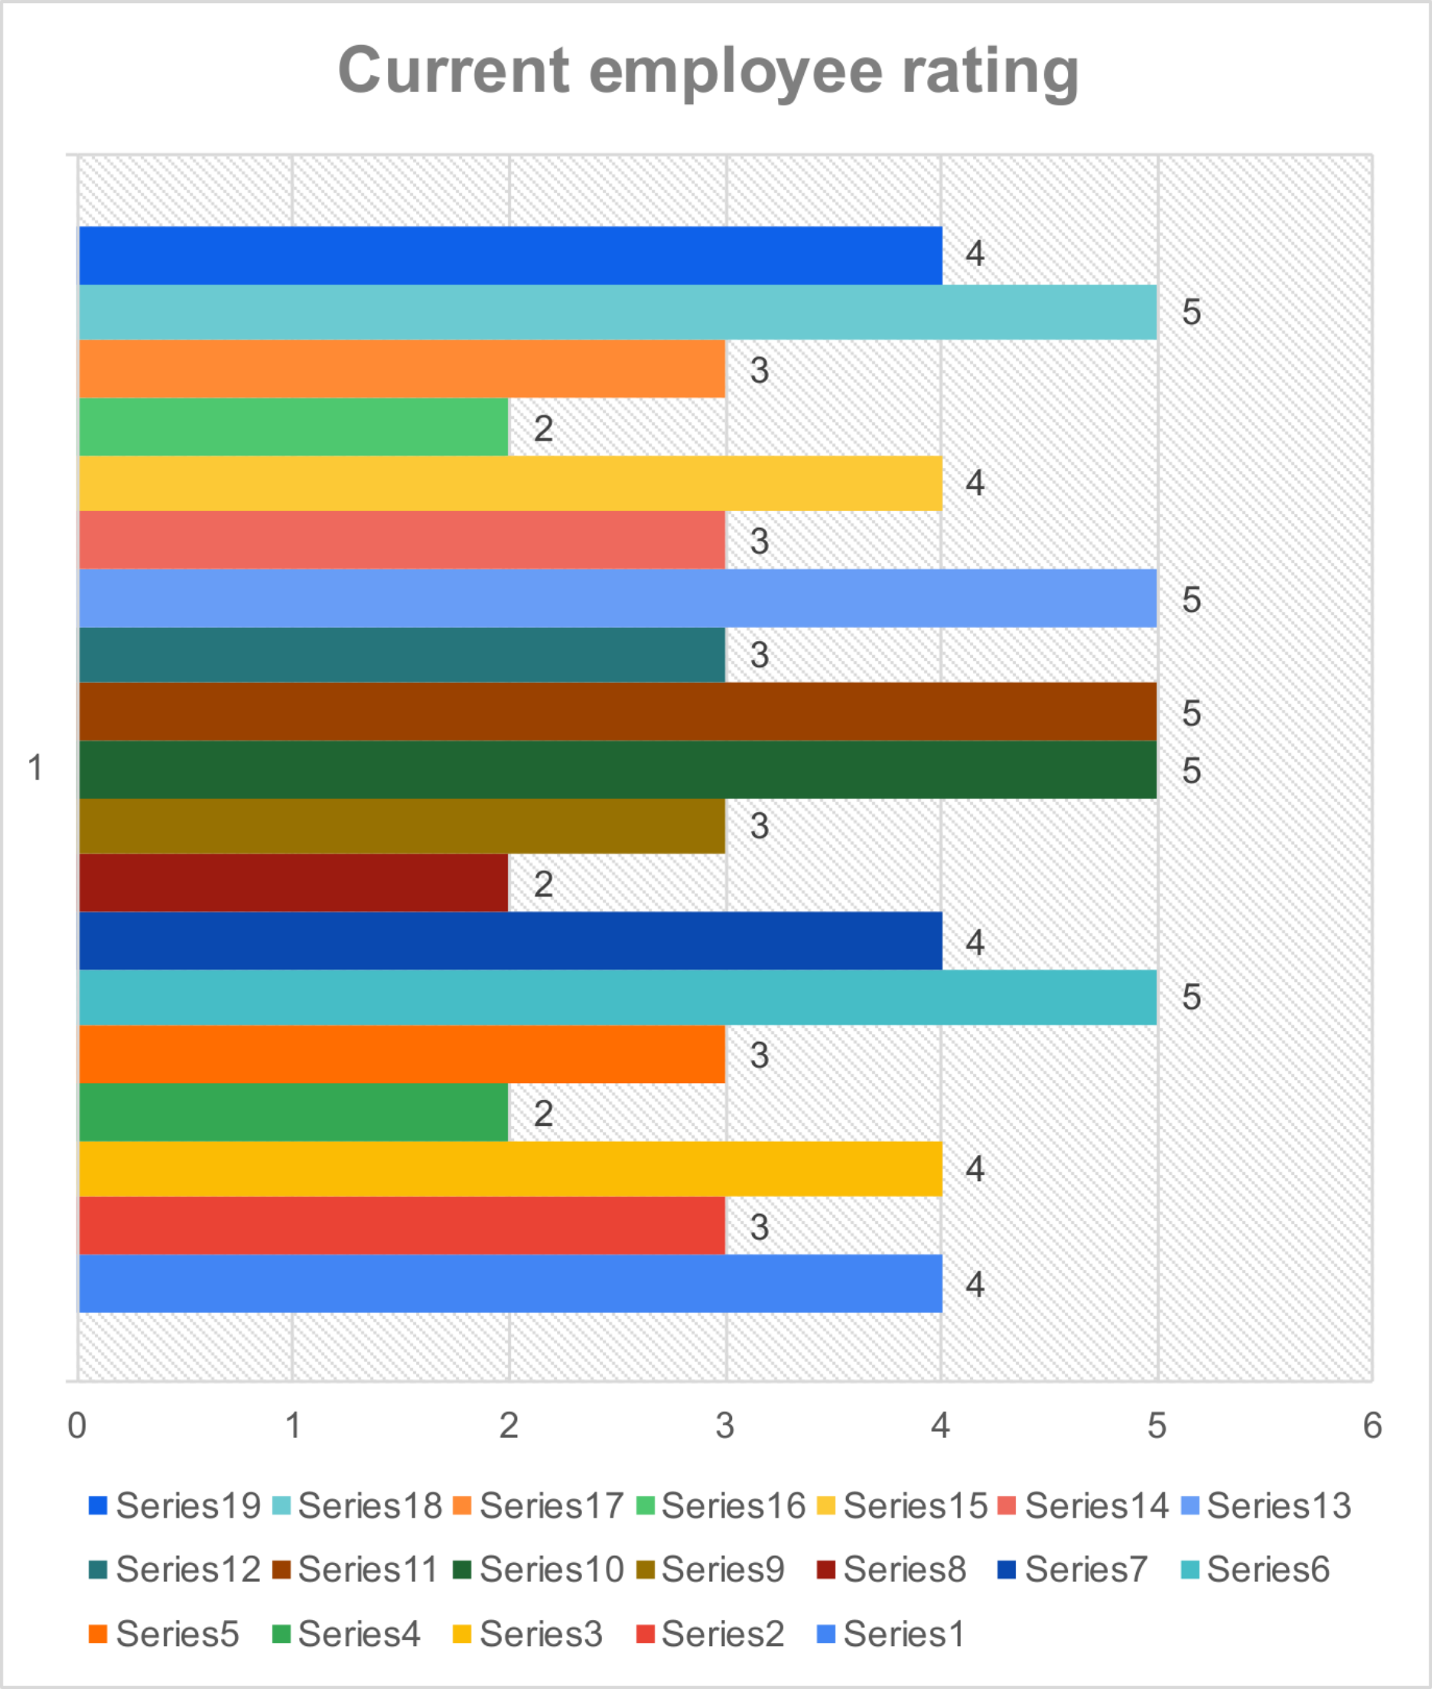
RESULTS
‹#›

Slide 13
Gender | (All)
Sum of current employee rating | Column Labels
 | Qtr1 | Qtr2 | Qtr3 | Qtr4 | Grand Total
Row Labels
2018 |  |  | 6 | 4 | 10
2019 |  | 7 | 6 | 3 | 16
2020 | 5 |  |  | 2 | 7
2021 | 4 | 5 | 2 | 5 | 16
2022 | 5 | 9 |  |  | 14
2023 | 3 |  | 5 |  | 8
Grand Total | 17 | 21 | 19 | 14 | 71

Slide 14
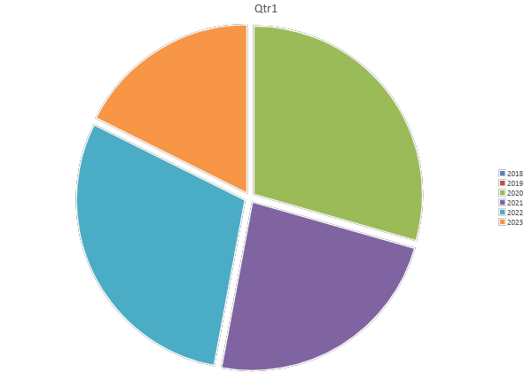

Slide 15
conclusion
In conclusion, this project provides valuable insights into the credit rating process and serves as a foundation for future financial analysis and strategy development. These insights can help financial institutions make informed lending decisions and offer tailored financial products to customers. The project successfully analyzed the credit ratings of various entities, identifying key factors that impact credit scores such as payment history, credit utilization, and financial stability.

